Slide 1

Multimedia Data Management
Lecture 4 – Normalization
Fall 2022

Slide 2
What features does a good relational design have?

Slide 3
Good Relational Design
In general, the goal of relational database design is to generate a set of relation schemas that allows us to store information without unnecessary redundancy, yet also allows us to retrieve information easily.
This is accomplished by designing schemas that are in an appropriate normal form.

Slide 4
Review of University Schema
classroom(building, room_number, capacity)
department(dept_name, building, budget)
course(course_id, title, dept_name, credits)
instructor(ID, name, dept_name, salary)
section(course_id, sec_id, semester, year, building, room_number, time_slot_id)
teaches(ID, course_id, sec_id, semester, year)
student(ID, name, dept_name, tot_cred)
takes(ID, course_id, sec_id, semester, year, grade)
advisor(sID, iID)
timeslot(time_slot_id, day, start_time, end_time)
prereq(course_id, prereq_id)

Slide 5
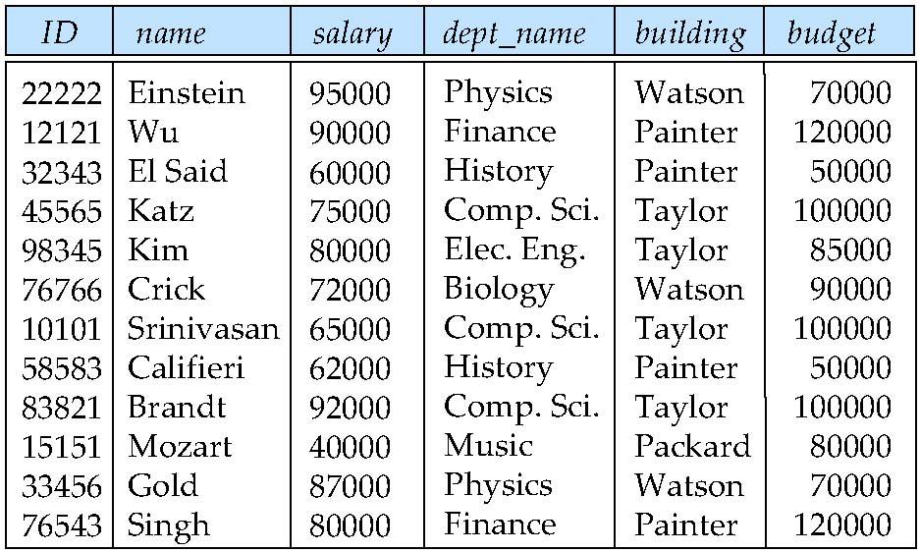
Combine Schemas
Suppose we combine instructor and department into inst_dept
(This is not the same as the relation)

Slide 6
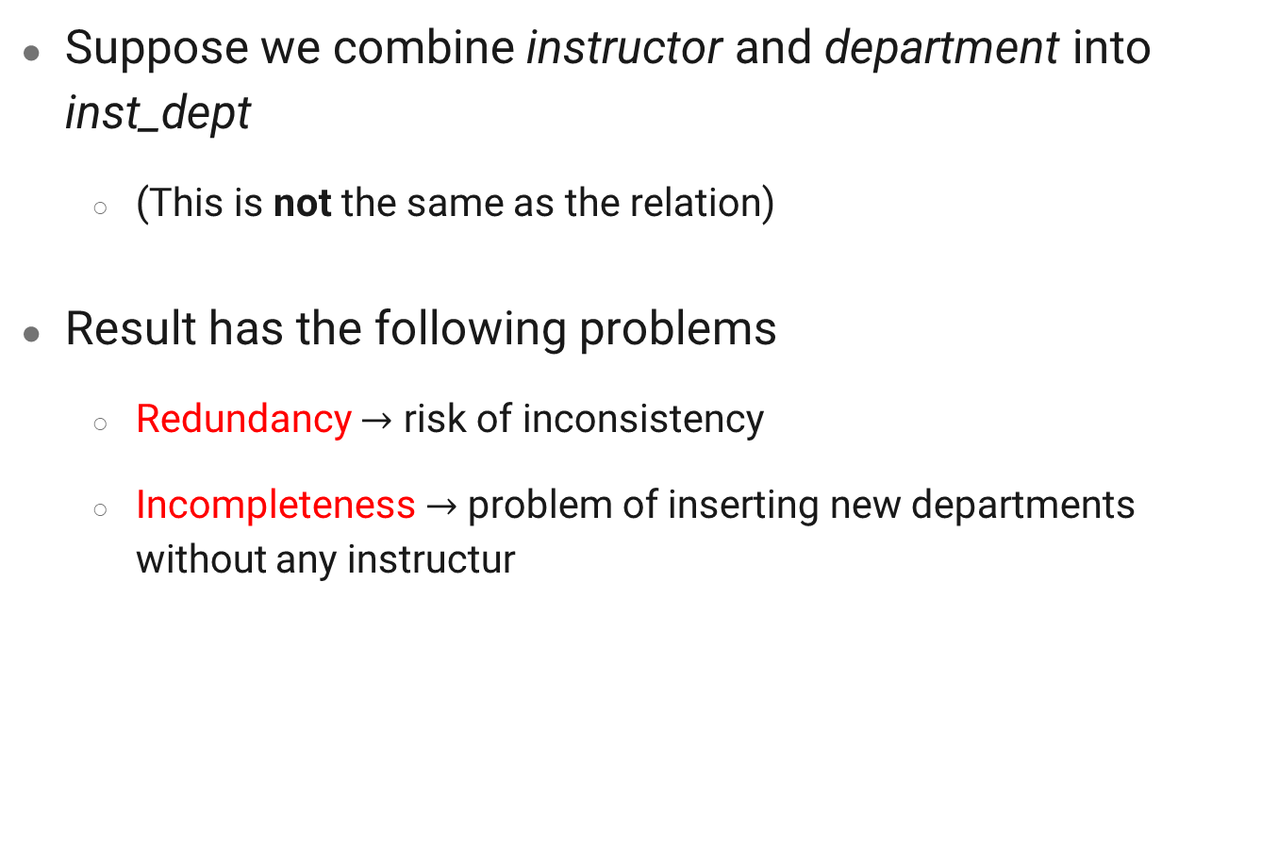
Combine Schemas
Suppose we combine instructor and department into inst_dept
(This is not the same as the relation)
Result has the following problems
Redundancy $→$ risk of inconsistency
Incompleteness $→$ problem of inserting new departments without any instructur

Slide 7
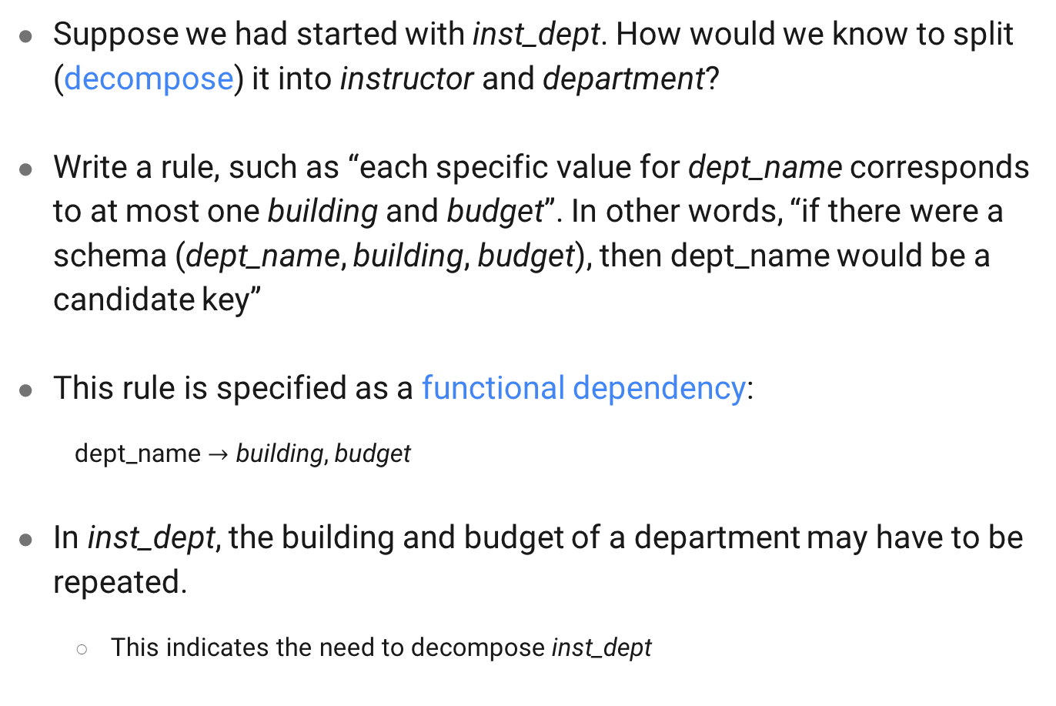
Split Schemas
Suppose we had started with inst_dept. How would we know to split (decompose) it into instructor and department?
Write a rule, such as “each specific value for dept_name corresponds to at most one building and budget”. In other words, “if there were a schema (dept_name, building, budget), then dept_name would be a candidate key”
This rule is specified as a functional dependency:
dept_name $→$ building, budget
In inst_dept, the building and budget of a department may have to be repeated.
This indicates the need to decompose inst_dept

Slide 8
Split Schemas
Finding the right decomposition is hard for schemas with many attributes and several functional dependencies.
Not all decompositions are good.
Suppose we decompose employee(ID, name, street, city, salary) into
employee1 (ID, name)
employee2 (name, street, city, salary)
Such decomposition results in losing information -- we cannot reconstruct the original employee relation -- and so, this is a lossy decomposition.

Slide 9
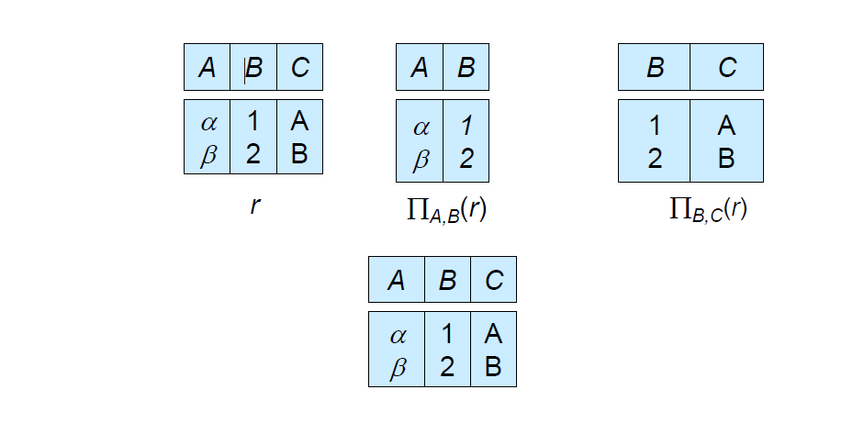


Lossless join decomposition
Lossless join decomposition
Decomposition of R = (A, B, C)
$$R_{1}=\left(A, B\right) R_{2}=(B, C)$$
$$R_{1} ⋈R_{2}$$

Slide 10
First Normal Form
Domain is atomic if its elements have no substring and are indivisible units
Examples of non-atomic domains:
Set of names, composite attributes
Identification numbers like CS101 that can be broken up into parts
A relational schema R is in first normal form if the domains of all attributes of R are atomic

Slide 11
First Normal Form
Atomicity is a property of how the elements of the domain are used.
Example: Strings would normally be considered indivisible
Suppose that students are given roll numbers which are strings of the form CS0012 or EE1127
If the first two characters are extracted to find the department, the domain of roll numbers is not atomic
Doing so is a bad idea, leads to encoding of information in application program rather than in the database
Notes:
However, the database application still treats the domain as atomic, if it does not attempt to split the identifier and interpret parts of the identifier as a department abbreviation. The course schema stores the department name as a separate attribute, and the database application can use this attribute value to find the department of a course, instead of interpreting particular characters of the course identifier. Thus, our university schema can be in first normal form.

Slide 12
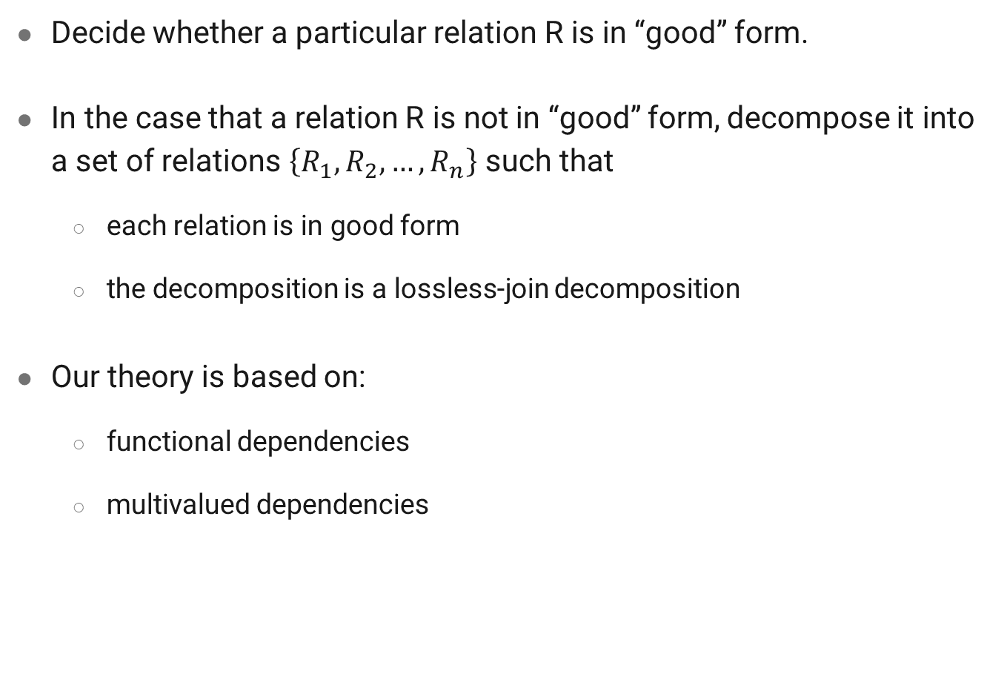
First Normal Form
Decide whether a particular relation R is in “good” form.
In the case that a relation R is not in “good” form, decompose it into a set of relations $\left\{R_{1},R_{2}, …,R_{n}\right\}$ such that
each relation is in good form
the decomposition is a lossless-join decomposition
Our theory is based on:
functional dependencies
multivalued dependencies

Slide 13
Functional Dependencies
Defining all constraints (rules) on the data (the set of legal relations) in the real world
Require that the value for a certain set of attributes determines uniquely the value for another set of attributes
A functional dependency is a generalization of the notion of a key

Slide 14
Functional Dependencies
Example: some of the constraints that are expected to hold in a university database
Students and instructors are uniquely identified by their ID
Each student and instructor has only one name
Each instructor and student is (primarily) associated with only one department
Each department has only one value for its budget, and only one associated building

Slide 15
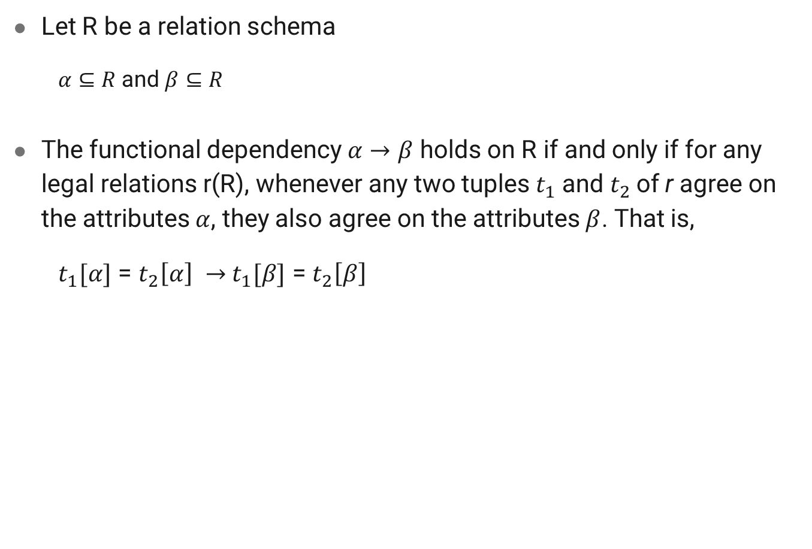
Functional Dependencies
Let R be a relation schema
$α⊆R$and $β⊆R$
The functional dependency $α→β$ holds on R if and only if for any legal relations r(R), whenever any two tuples $t_{1}$ and $t_{2}$of r agree on the attributes $α$, they also agree on the attributes $β$. That is,
$t_{1}[α]$ = $t_{2}\left[α\right] →$ $t_{1}[β]$ = $t_{2}\left[β\right]$
Notes:
Consider r(A,B ) with the following instance of r.
(1, 4) (1, 5) (3, 7)
On this instance, A $→$ B does NOT hold, but B $→$ A does hold.

Slide 16
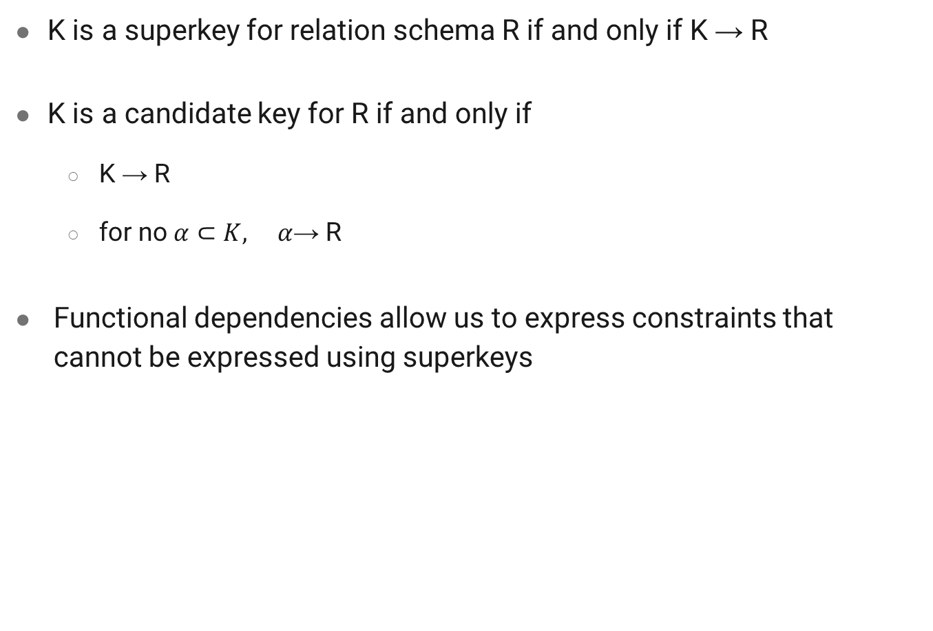
Functional Dependencies
K is a superkey for relation schema R if and only if K → R
K is a candidate key for R if and only if
K → R
for no $α⊂K, α\text{→ }\text{R}$
Functional dependencies allow us to express constraints that cannot be expressed using superkeys

Slide 17
Functional Dependencies
Consider the schema inst_dept(ID, name, salary, dept_name, building, budget). We expect these functional dependencies to hold:
dept_name → building
ID → building
but would not expect the following to hold:
dept_name → salary
We denote the fact that the pair of attributes (ID, dept _name) forms a superkey for inst_dept by writing:
ID, dept_name → name, salary, building, budget

Slide 18
Functional Dependencies – Use case
We use functional dependencies to:
test relations to see if they are legal under a given set of functional dependencies.
If relation r is legal under a set F of functional dependencies, we say that r satisfies F.
Specify constraints of the set of legal relations
We say that F holds on R if all legal relations on R satisfy the set of functional dependencies F.

Slide 19
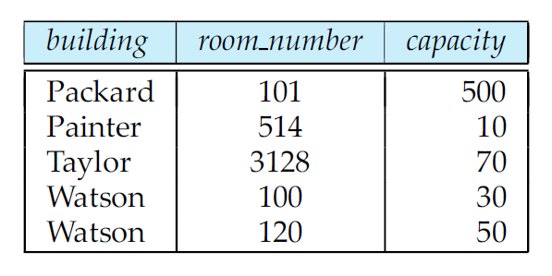
Functional Dependencies – Use case
Note: A specific instance of a relation schema may satisfy a functional dependency even if the functional dependency does not hold on all legal instances.
Example: In the following instance of the classroom relation, we see the following functional dependency is satisfied.
room_number → capacity
However, we know that in the real world, two calassrooms in different buildings can have the same room number but with different room capacity.

Slide 20
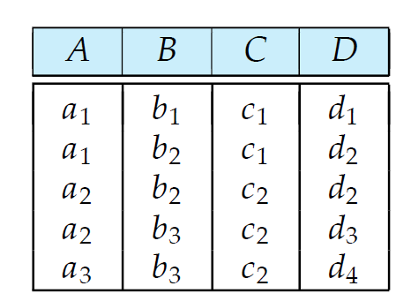
Functional Dependencies – Use case
Let us consider the following instance of relation r, to see which functional dependencies are satisfied.
Observe that A → C is satisfied.
There are two tuples that have an A value of a1. These tuples have the same C value, namely c1.
Similarly, the two tuples with an A value of a2 have the same C value, c2.
There are no other pairs of distinct tuples that have the same A value.

Slide 21
Functional Dependencies – Use case
Let us consider the following instance of relation r, to see which functional dependencies are satisfied.
The functional dependency C → A is not satisfied, however
Consider the tuples t4 and t5.
These two tuples have the same C values, c2, but they have different A values, a2 and a3, respectively.
There is a pair of tuples t4 and t5 such that
t4[C] = t5[C], but t4[A] ≠ t4[A].

Slide 22

Functional Dependencies
A functional dependency is trivial if it is satisfied by all instances of a relation
Example:
ID, name → ID
name → name
In general, $α$→ $β$ is trivial if $β ⊆α$

Slide 23
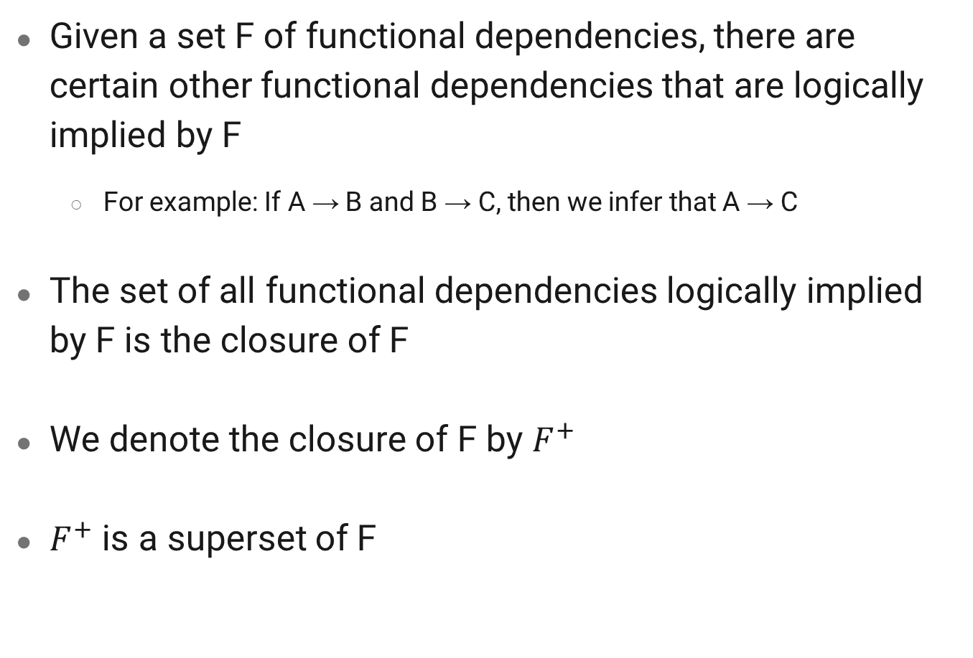
Closure
Given a set F of functional dependencies, there are certain other functional dependencies that are logically implied by F
For example: If A → B and B → C, then we infer that A → C
The set of all functional dependencies logically implied by F is the closure of F
We denote the closure of F by $F^{+}$
$F^{+}$ is a superset of F

Slide 24
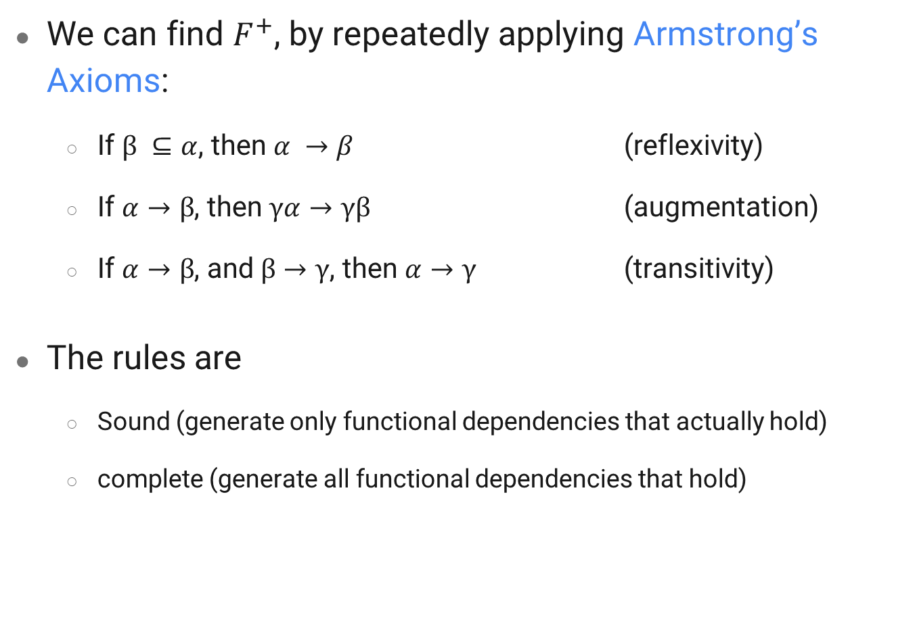
Closure
We can find $F^{+}$, by repeatedly applying Armstrong’s Axioms:
If $β ⊆α$, then $α →β$ (reflexivity)
If $α→β$, then $γα→γβ$ (augmentation)
If $α→β$, and $β→γ$, then $α→γ$ (transitivity)
The rules are
Sound (generate only functional dependencies that actually hold)
complete (generate all functional dependencies that hold)

Slide 25

Example
R = (A, B, C, G, H, I)
F = { A $→$ B
A $→$ C
CG $→$ H
CG $→$ I
B $→$ H }
Some members of $F^{+}$
A $→$ H
AG $→$ I
Notes:
by transitivity from A $→$ B and B $→$ H
by augmenting A $→$ C with G, to get AG $→$ CG and then transitivity with CG $→$ I

Slide 26
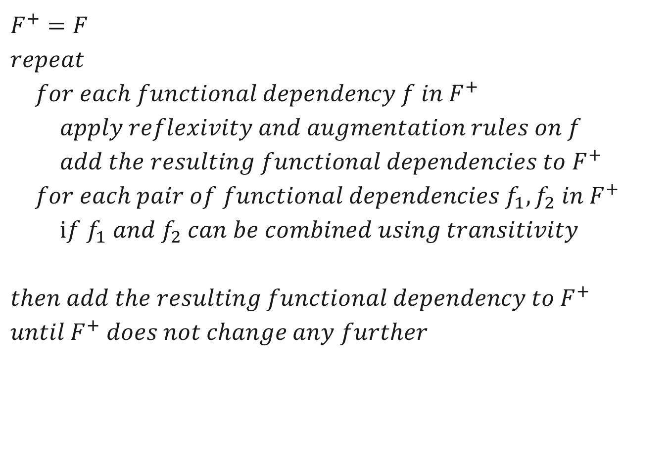
Computing the Closure
$F^{+}=F$
$repeat$
$for each functional dependency f in F^{+}$
$apply reflexivity and augmentation rules on f$
$add the resulting functional dependencies to F^{+}$
$for each pair of functional dependencies f_{1},f_{2} in F^{+}$
$if f_{1} and f_{2} can be combined using transitivity$
$then add the resulting functional dependency to F^{+}$
$until F^{+} does not change any further$
Notes:
Is it a good algorithm?

Slide 27

Closure for Functional Dependencies
Additional rules:
If $α→β$, and $α →γ$, then $α→ βγ$ (union)
If $α→ βγ$, then $α→ γ$and $α→ β$ (decomposition)
If $α→ β$, and $βγ → δ,$ then $α γ → δ$ (pseudotransitivity)
Notes:
The above rules can be inferred from Armstrong’s axioms

Slide 28

Example
R = (A, B, C, G, H, I)
F = { A $→$ B
A $→$ C
CG $→$ H
CG $→$ I
B $→$ H }
Some members of $F^{+}$
AG $→$ I
CG $→$ HI
Notes:
A  C => AG  CG CG  I
union with CG  H and CG  I

Slide 29
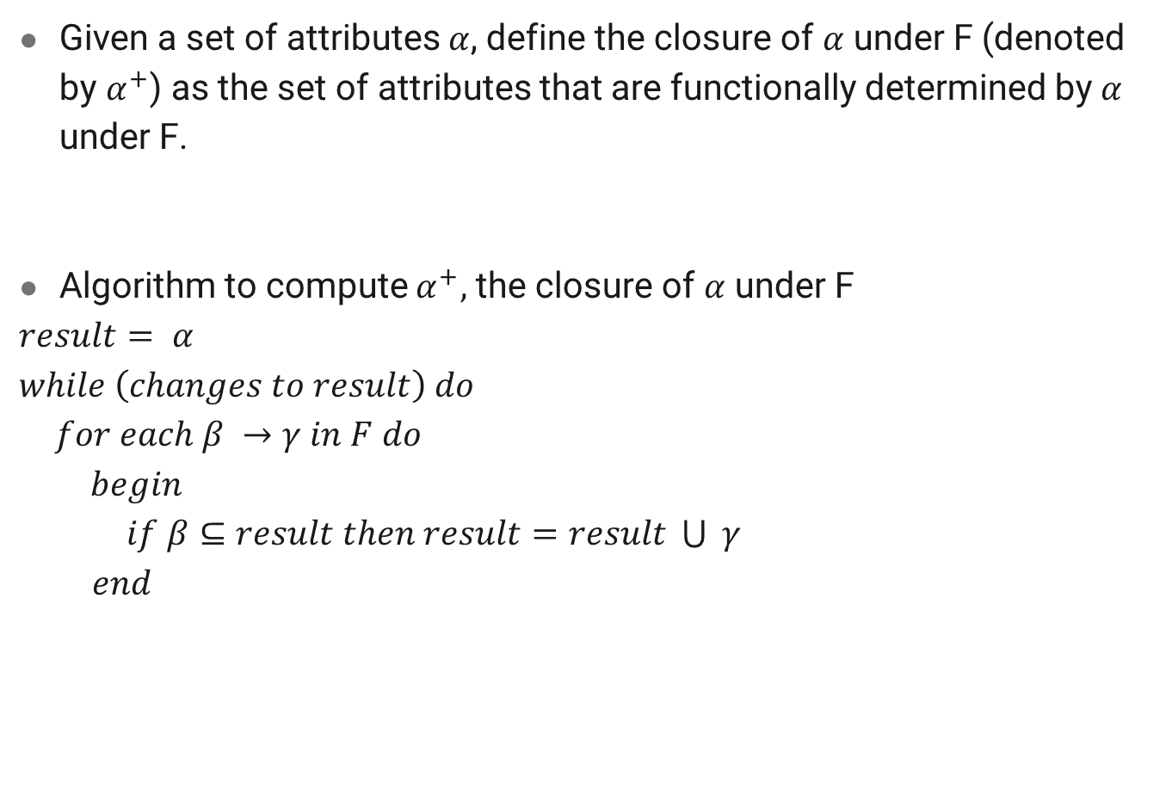
Closure of Attribute Sets
Given a set of attributes $α$, define the closure of $α$ under F (denoted by $α^{+}$) as the set of attributes that are functionally determined by $α$ under F.
Algorithm to compute $α^{+},$ the closure of $α$ under F
$result= α$
$while \left(changes to result\right) do$
$for each β →γ in F do$
$begin$
$if β⊆result then result=result \bigcup{ γ}$
$end$

Slide 30

Example
R = (A, B, C, G, H, I)
F = { A $→$ B
A $→$ C
CG $→$ H
CG $→$ I
B $→$ H }
Compute ${(AG)}^{+}$
Usage of the attribute closure: Testing for superkey
Notes:
result = AG
2.result = ABCG (A  C and A  B)
3.result = ABCGH (CG  H and CG  AGBC)
4.result = ABCGHI (CG  I and CG  AGBCH)
Is AG a candidate key?
Does AG $→$ R? == Is (AG)+ $⊇$ R
Is any subset of AG a superkey?
Does A $→$ R? == Is (A)+ $⊇$ R
Does G $→$ R? == Is (G)+ $⊇$ R

Slide 31
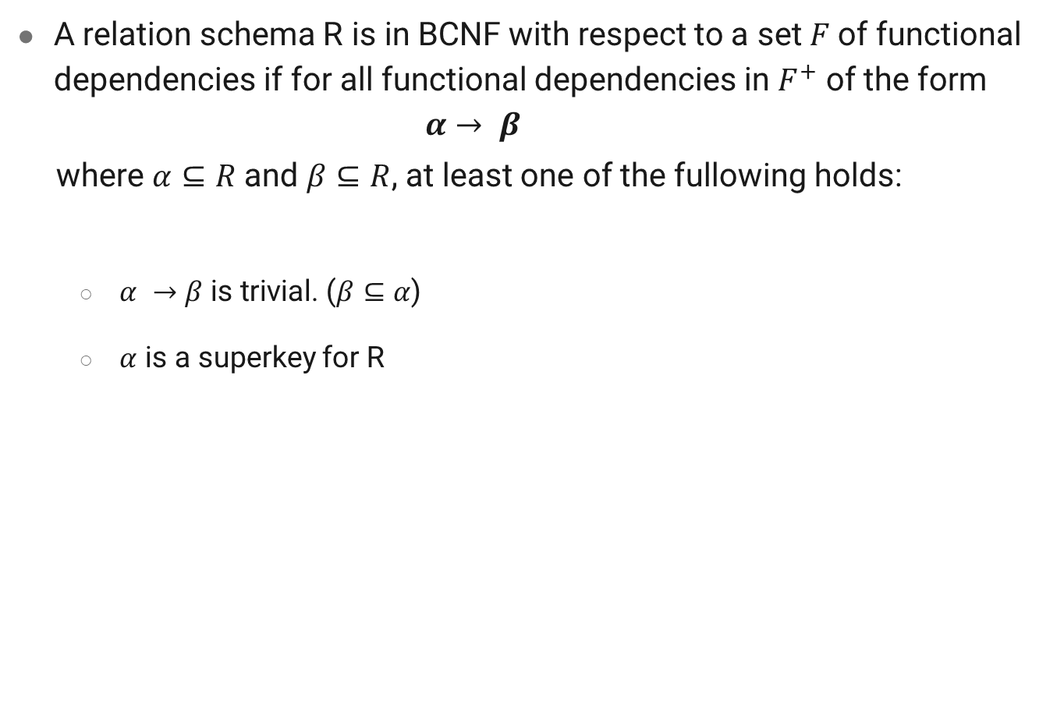
Boyce-Codd Normal Form
A relation schema R is in BCNF with respect to a set $F$of functional dependencies if for all functional dependencies in $F^{+}$ of the form
$$α→ β$$
where $α⊆R$ and $β⊆R$, at least one of the fullowing holds:
$α →β$ is trivial. ($β⊆α$)
$α$ is a superkey for R

Slide 32
Boyce-Codd Normal Form
Example
Is instr_dept (ID, name, salary, dept_name, building budget) in BCNF?
What about instructor (ID, name, salary, dept_name)?
Notes:
because dept_name building, budget holds on instr_dept, but dept_name is not a superkey
Because all of the nontrivial functional dependencies that hold, such as ID → name, dept_name, salary include ID on the left side of the arrow, and ID is a superkey for instructor.

Slide 33
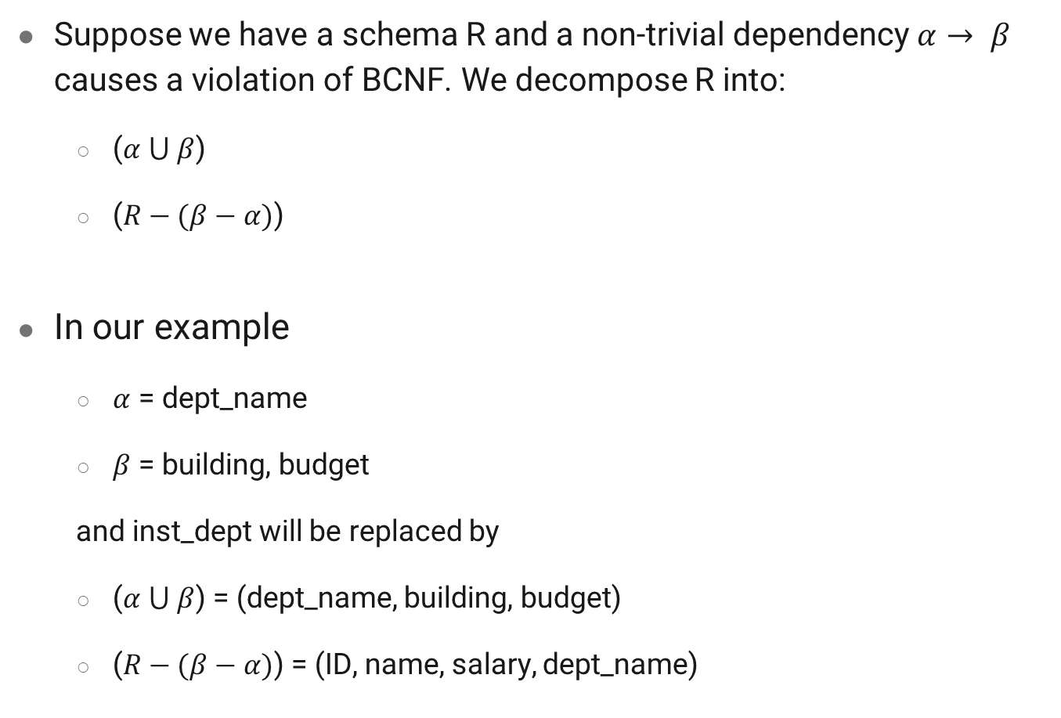
Decomposing a Schema into BCNF
Suppose we have a schema R and a non-trivial dependency $α→ β$ causes a violation of BCNF. We decompose R into:
($α ⋃ β$)
($R−(β−α)$)
In our example
$α$ = dept_name
$β$ = building, budget
and inst_dept will be replaced by
($α ⋃ β$) = (dept_name, building, budget)
($R−(β−α)$) = (ID, name, salary, dept_name)
Notes:
NOTE: When we decompose a schema that is not in BCNF, it may be that one or more of the resulting schemas are not in BCNF. In such cases, further decomposition is required, the eventual result of which is a set of BCNF schemas

Slide 34
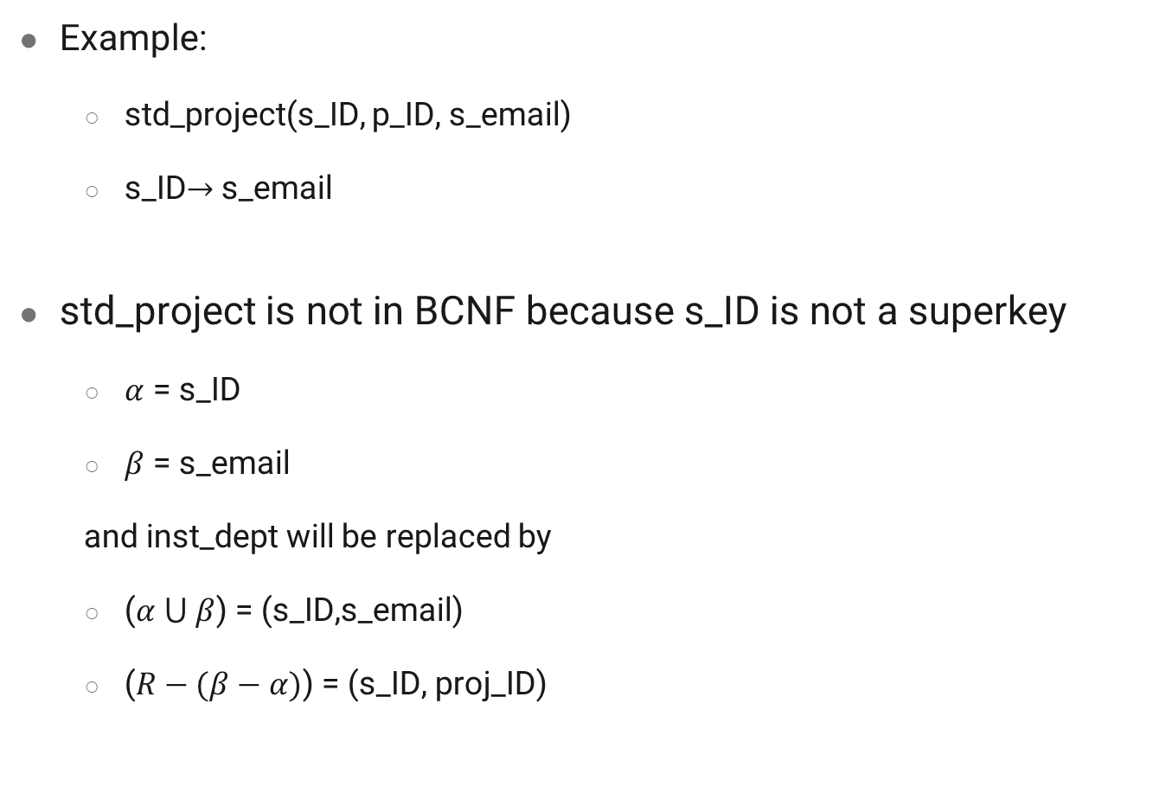
Example
Example:
std_project(s_ID, p_ID, s_email)
s_ID$→$ s_email
std_project is not in BCNF because s_ID is not a superkey
$α$ = s_ID
$β$ = s_email
and inst_dept will be replaced by
($α ⋃ β$) = (s_ID,s_email)
($R−(β−α)$) = (s_ID, proj_ID)

Slide 35
BCNF and Dependency Preservation
Constraints, including functional dependencies, are costly to check in practice unless they pertain to only one relation
If it is sufficient to test only those dependencies on each individual relation of a decomposition in order to ensure that all functional dependencies hold, then that decomposition is dependency preserving.
Because it is not always possible to achieve both BCNF and dependency preservation, we consider a weaker normal form, known as third normal form

Slide 36
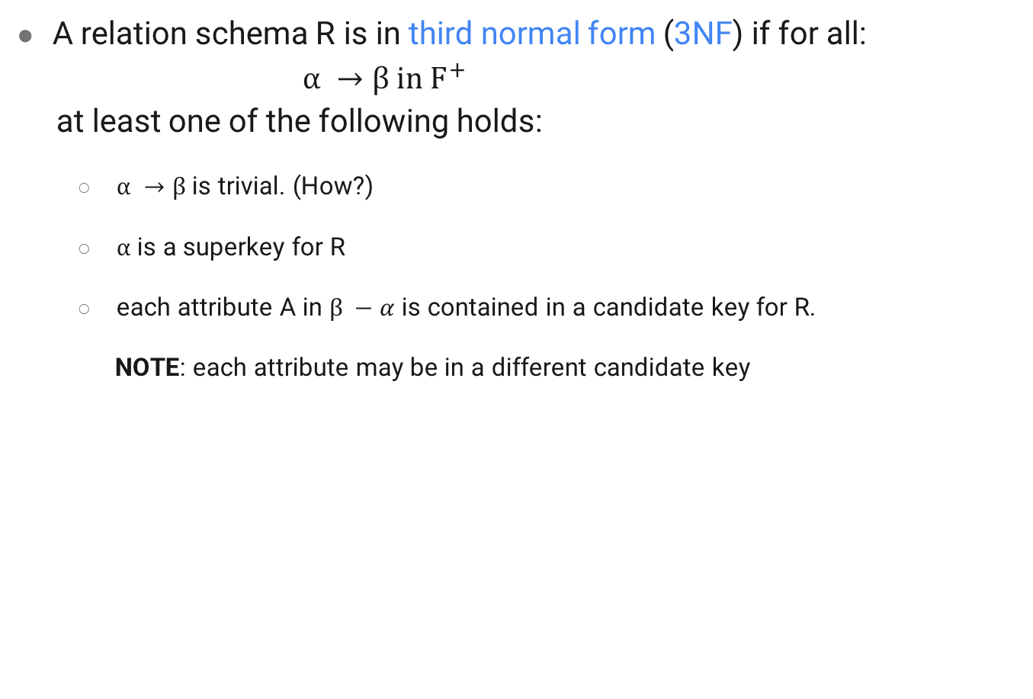
Third Normal Form
A relation schema R is in third normal form (3NF) if for all:
$$α →β in F^{+}$$
at least one of the following holds:
$α →β$ is trivial. (How?)
$α$ is a superkey for R
each attribute A in $β −α$ is contained in a candidate key for R.
NOTE: each attribute may be in a different candidate key

Slide 37
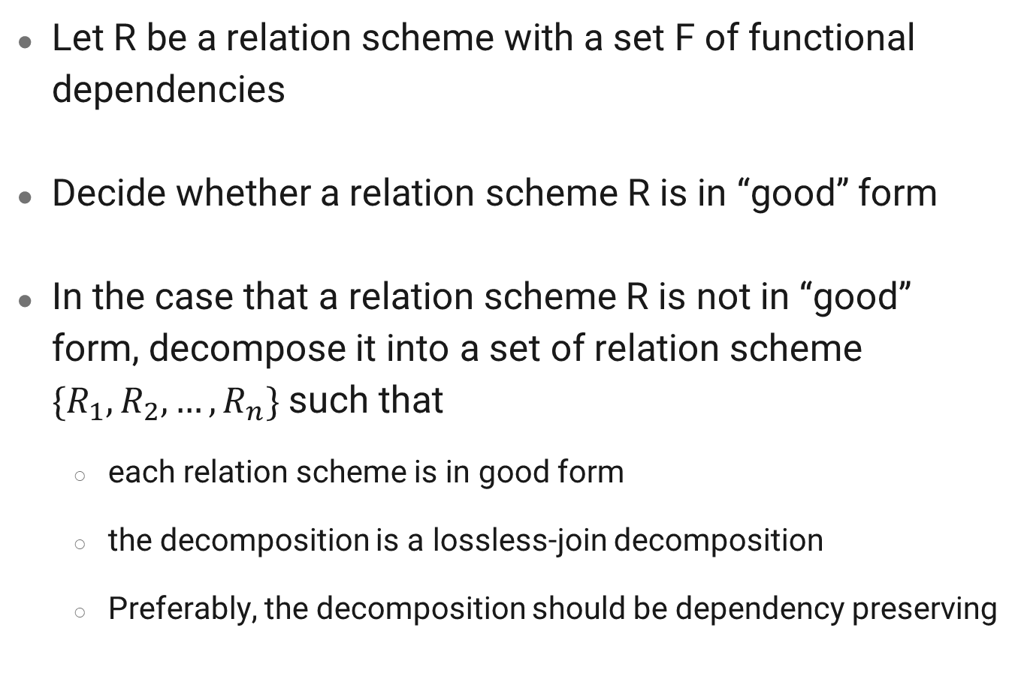
Normalization Goals
Let R be a relation scheme with a set F of functional dependencies
Decide whether a relation scheme R is in “good” form
In the case that a relation scheme R is not in “good” form, decompose it into a set of relation scheme $\{R_{1}, R_{2}, …, R_{n}\}$such that
each relation scheme is in good form
the decomposition is a lossless-join decomposition
Preferably, the decomposition should be dependency preserving

Slide 38
Functional-Dependency Theory
Considering the formal theory that tells us which functional dependencies are implied logically by a given set of functional dependencies
Developing algorithms to generate lossless decompositions into BCNF and 3NF
Developing algorithms to test if a decomposition is dependency-preserving

Slide 39
Canonical Cover
By any update performs by users on a relation schema, the database system must ensure that the update does not violate any functional dependencies; i.e., all the functional dependencies should be satisfied in the new database state
The system must roll back the update if it violates any functional dependencies
We can reduce the effort spent in checking for violations by testing a simplified set of functional dependencies that has the same closure as the given set

Slide 40
Canonical Cover
Any database that satisfies the simplified set of functional dependencies also satisfies the original set, and vice versa, since the two sets have the same closure. However, the simplified set is easier to test
Intuitively, a canonical cover of F is a “minimal” set of functional dependencies equivalent to F, having no redundant dependencies or redundant parts of dependencies

Slide 41
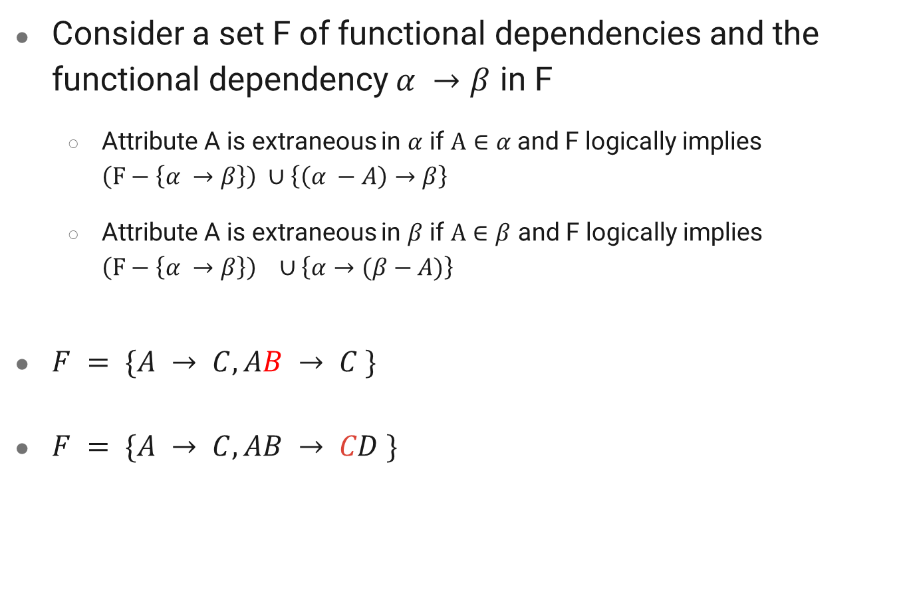
Extraneous Attributes
Consider a set F of functional dependencies and the functional dependency $α →β$ in F
Attribute A is extraneous in $α$ if $A∈α$ and F logically implies $\left(F−\left\{α →β\right\}\right) ∪\left\{\left(α −A\right)→β\right\}$
Attribute A is extraneous in $β$ if $A∈β$ and F logically implies $\left(F−\left\{α →β\right\}\right) ∪\left\{α→(β−A)\right\}$
$F = \{A → C, AB → C \}$
$F = \{A → C, AB → CD \}$

Slide 42
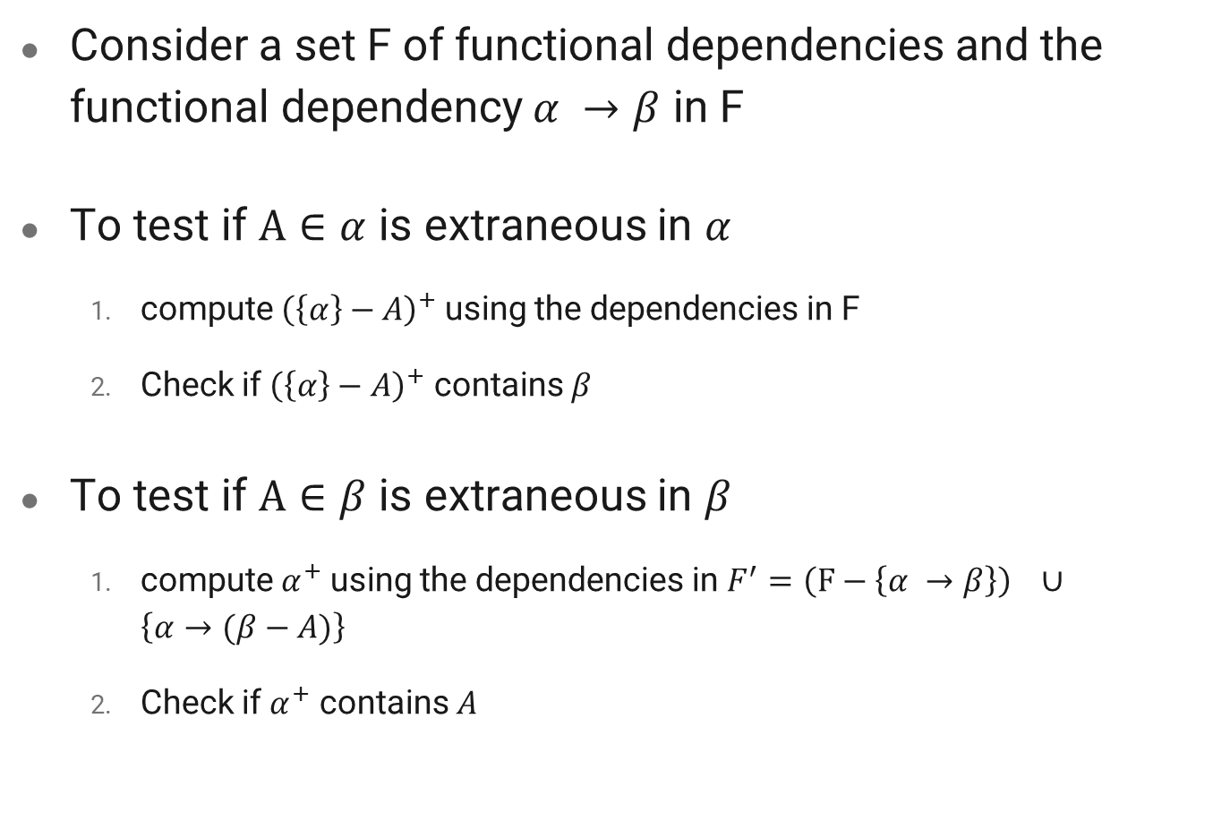
Testing if an Attribute is Extraneous
Consider a set F of functional dependencies and the functional dependency $α →β$ in F
To test if $A∈α$ is extraneous in $α$
compute ${\left(\left\{α\right\}−A\right)}^{+}$ using the dependencies in F
Check if ${\left(\left\{α\right\}−A\right)}^{+}$ contains $β$
To test if $A∈β$ is extraneous in $β$
compute $α^{+}$ using the dependencies in $F^{′}=\left(F−\left\{α →β\right\}\right) ∪\left\{α→(β−A)\right\}$
Check if $α^{+}$ contains $A$

Slide 43

Extraneous Attribute
Example
Given F = {$A → C, AB → C$}
B is extraneous in $AB → C$
${\left(\left\{α\right\}−A\right)}^{+}$ under F contains $β$
$A^{+}=AC$
Example
Given F = {$AB→CD, A→E, E→C$}
C is extraneous in $AB → CD$
$α^{+}$ under F’ contains C
${(AB)}^{+}=ABCDE$

Slide 44
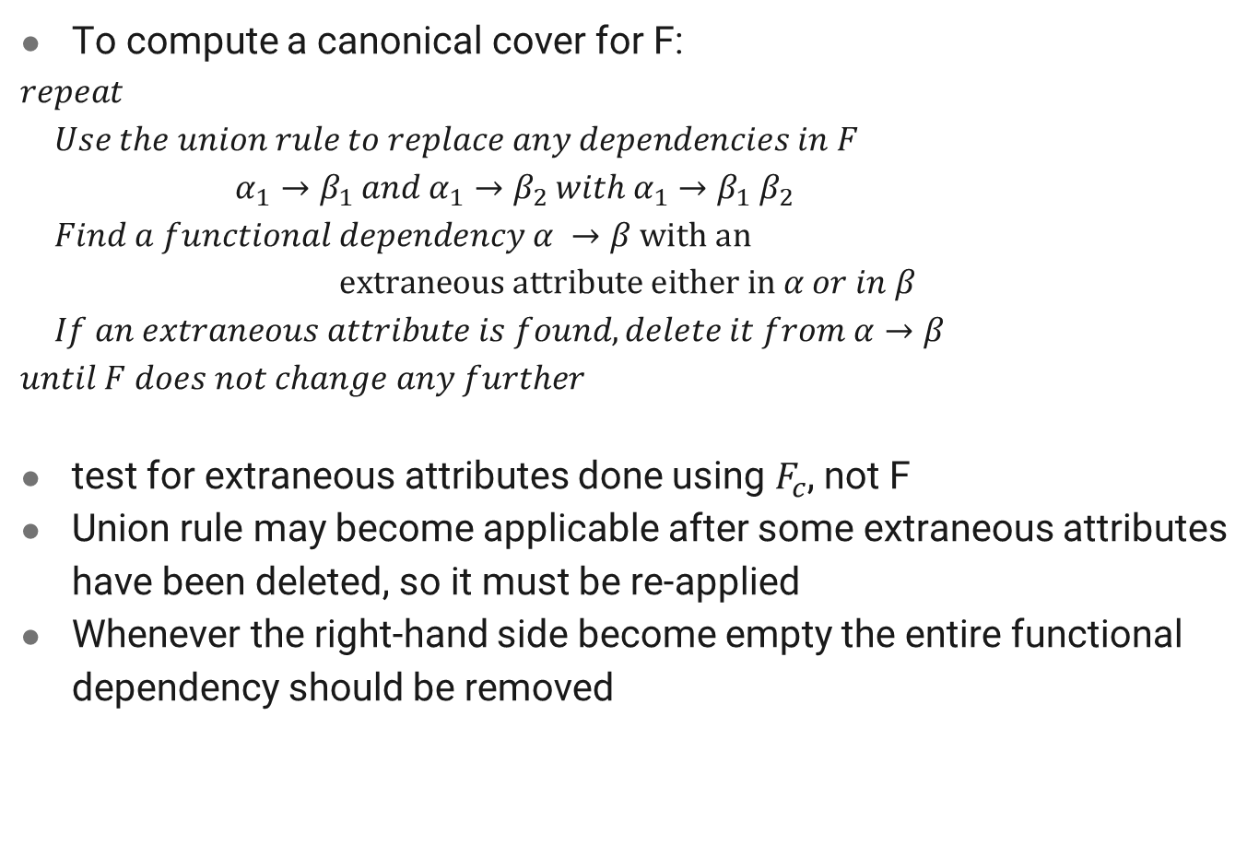
Canonical Cover
To compute a canonical cover for F:
$repeat$
$Use the union rule to replace any dependencies in F$
$α_{1}→β_{1} and α_{1}→β_{2} with α_{1}→β_{1}$ $β_{2}$
$Find a functional dependency α →β with an$
$$extraneous attribute either in α or in β$$
$If an extraneous attribute is found, delete it from α→β$
$until F does not change any further$
test for extraneous attributes done using $F_{c}$, not F
Union rule may become applicable after some extraneous attributes have been deleted, so it must be re-applied
Whenever the right-hand side become empty the entire functional dependency should be removed

Slide 45
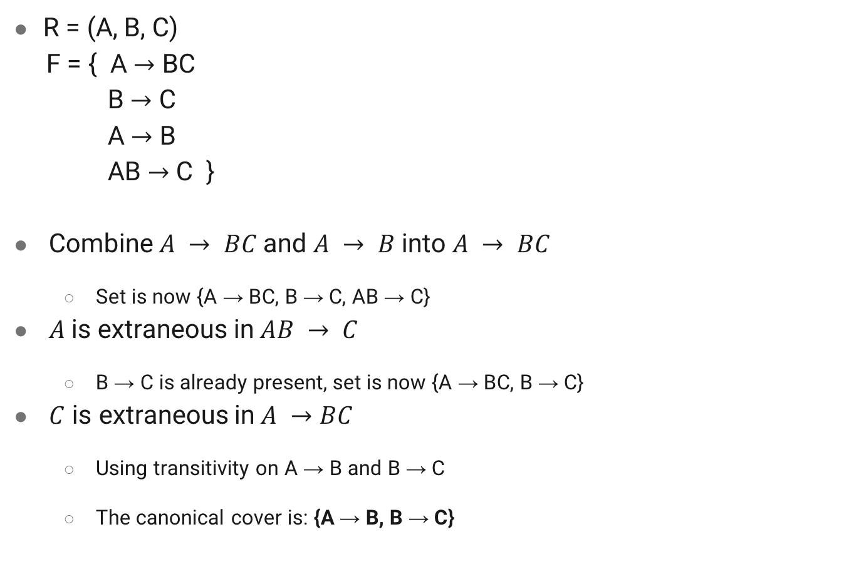
Example
R = (A, B, C)
F = { A $→$ BC
B $→$ C
A $→$ B
AB $→$ C }
Combine $A → BC$and $A → B$ into $A → BC$
Set is now {A → BC, B → C, AB → C}
$A$is extraneous in$AB → C$
B → C is already present, set is now {A → BC, B → C}
$C$ is extraneous in$A →BC$
Using transitivity on A → B and B → C
The canonical cover is: {A → B, B → C}
Notes:
Check if A  C is logically implied

Slide 46
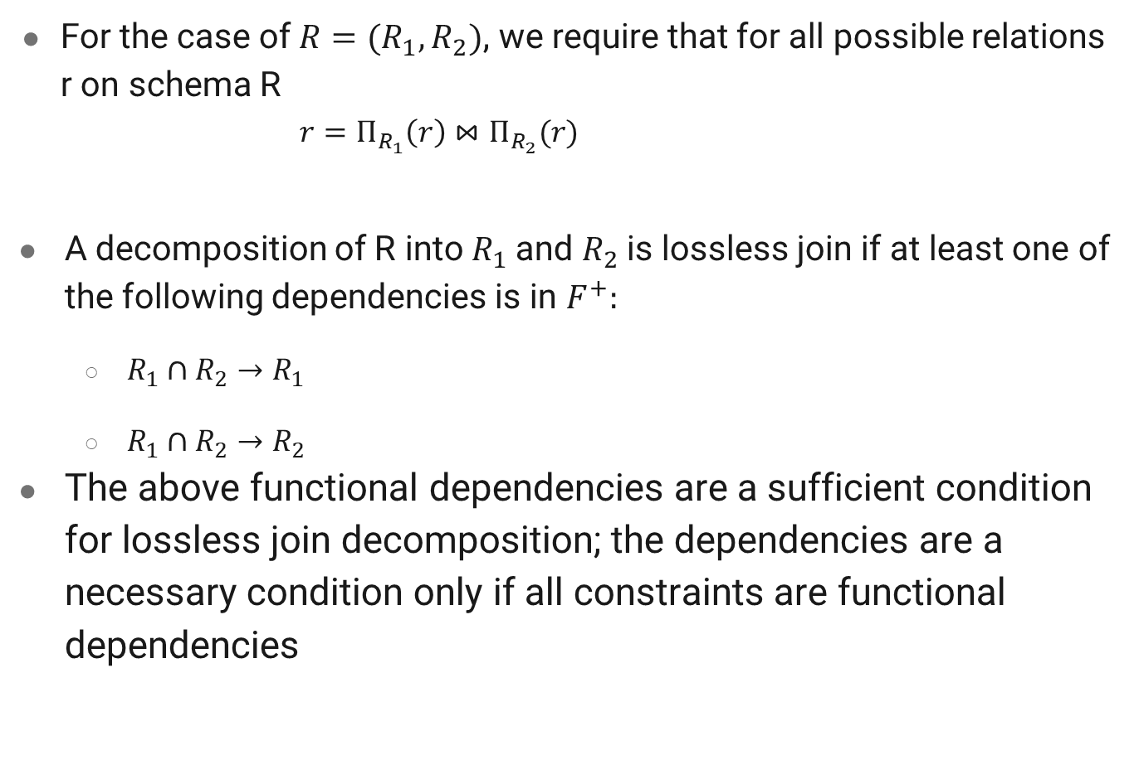
Lossless-join Decomposition
For the case of $R=(R_{1}, R_{2})$, we require that for all possible relations r on schema R
$$r=Π_{R_{1}}\left(r\right)⋈Π_{R_{2}}(r)$$
A decomposition of R into $R_{1}$and $R_{2}$is lossless join if at least one of the following dependencies is in $F^{+}:$
$R_{1}∩R_{2}→R_{1}$
$R_{1}∩R_{2}→R_{2}$
The above functional dependencies are a sufficient condition for lossless join decomposition; the dependencies are a necessary condition only if all constraints are functional dependencies

Slide 47

Example
R = (A, B, C)
F = { A $→$ B
B $→$ C}
Key = $\left\{A\right\}$
R is not in BCNF
Decomposition $R_{1}=\left(A, B\right), R_{2}=\left(B,C\right)$
$R_{1}$ and $R_{2}$ in BCNF
Lossless-join decomposition $R_{1}∩R_{2}=\left\{B\right\}$ and $B→BC$
Dependency preserving

Slide 48
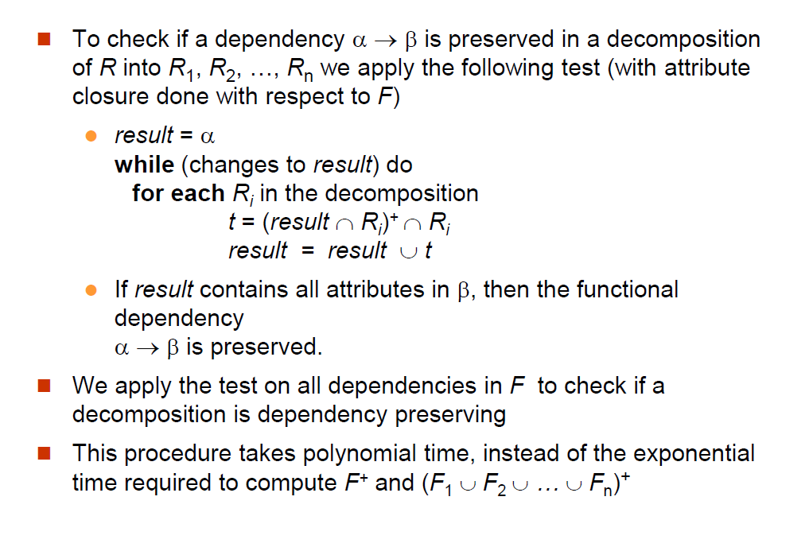
Testing for Dependency Preservation

Slide 49
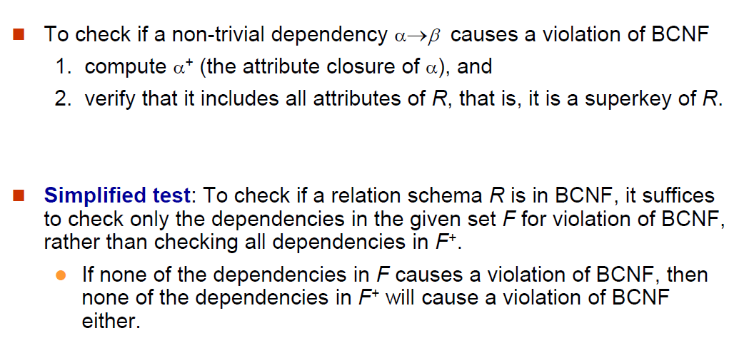
Testing for BCNF

Slide 50
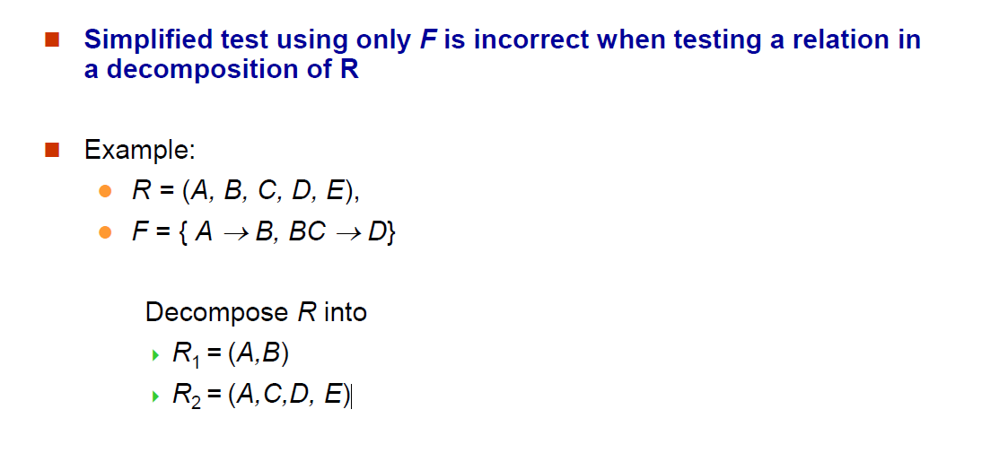
Testing for BCNF
Notes:
Neither of the dependencies in F contain only attributes from (A,C,D,E)
–We might think R2 satisfies BCNF.
–In fact, dependency AC  D in F+ shows R2 is not in BCNF.

Slide 51
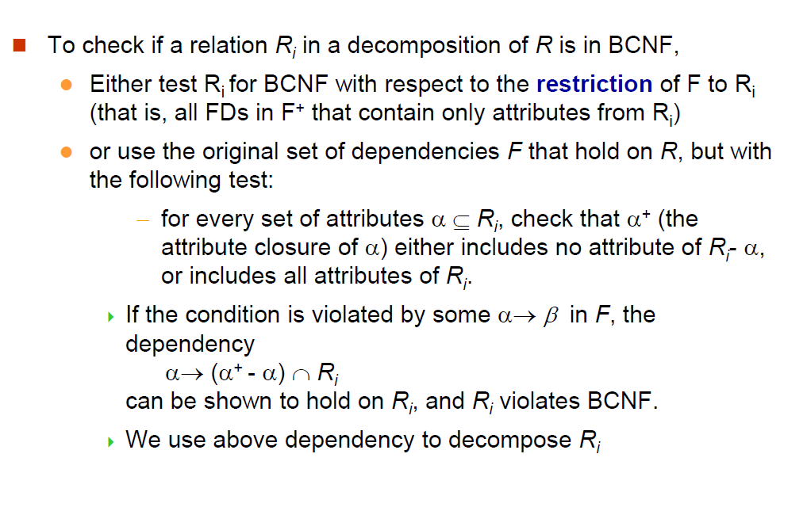
Testing Decomposition for BCNF

Slide 52
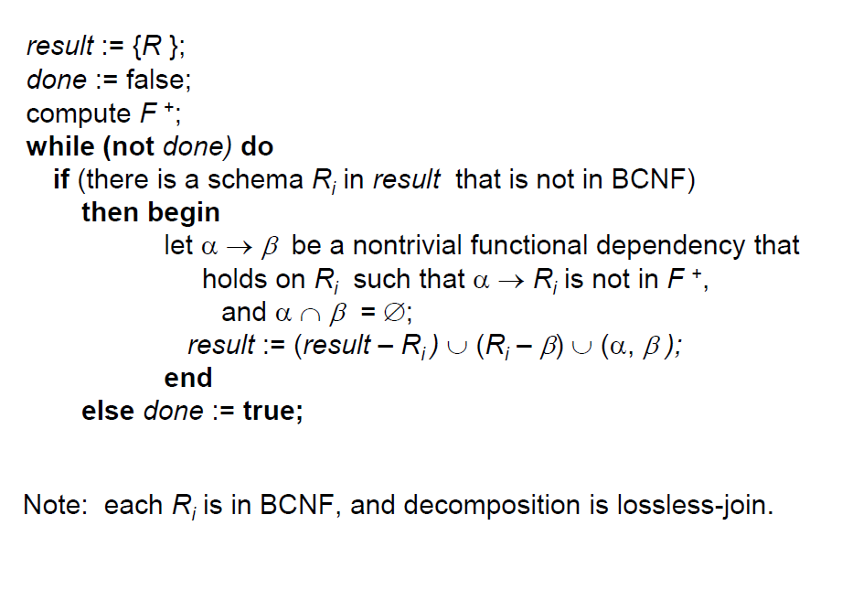
BCNF Decomposition Algorithm

Slide 53
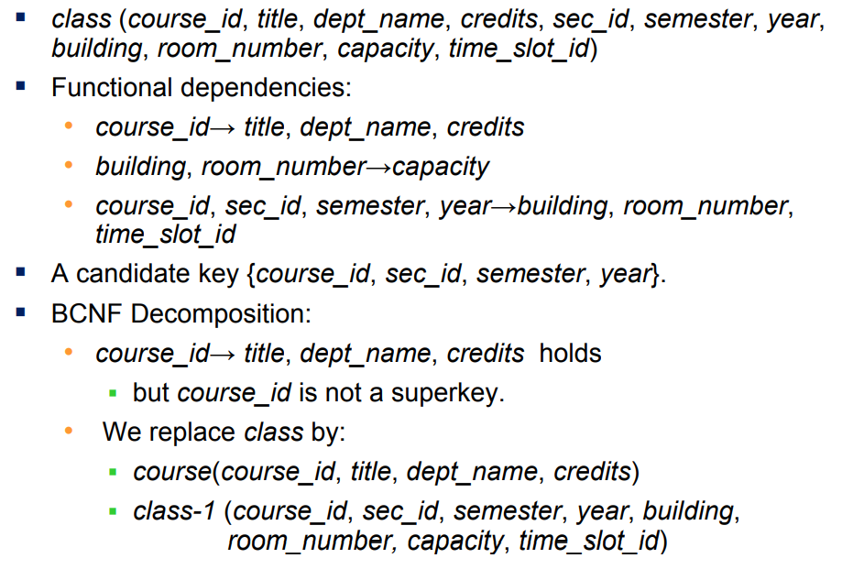
BCNF Decomposition Example

Slide 54
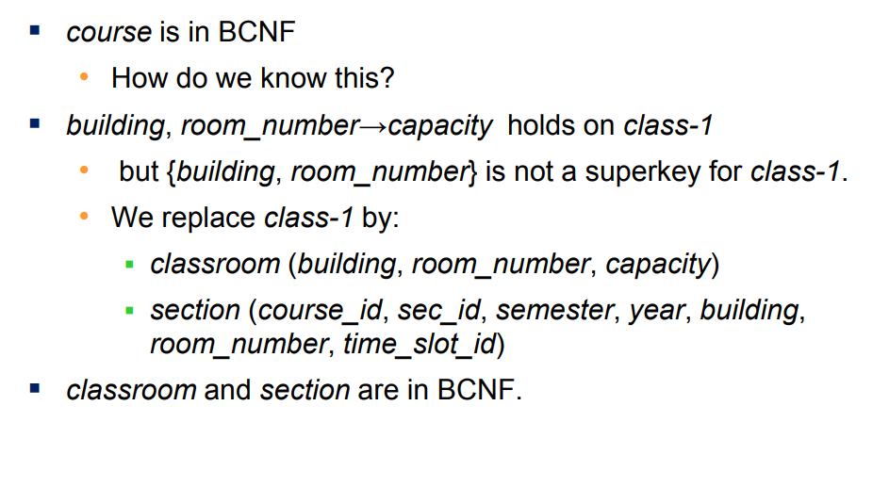
BCNF Decomposition Example

Slide 55
3NF Motivation
There are some situations where
BCNF is not dependency preserving
efficient checking for FD violation on updates is important
Solution: define a weaker normal form, called Third Normal Form (3NF)
Allows some redundancy (may also cause problems)
But functional dependencies can be checked on individual relations without computing a join.
There is always a lossless-join, dependency-preserving decomposition into 3NF.

Slide 56
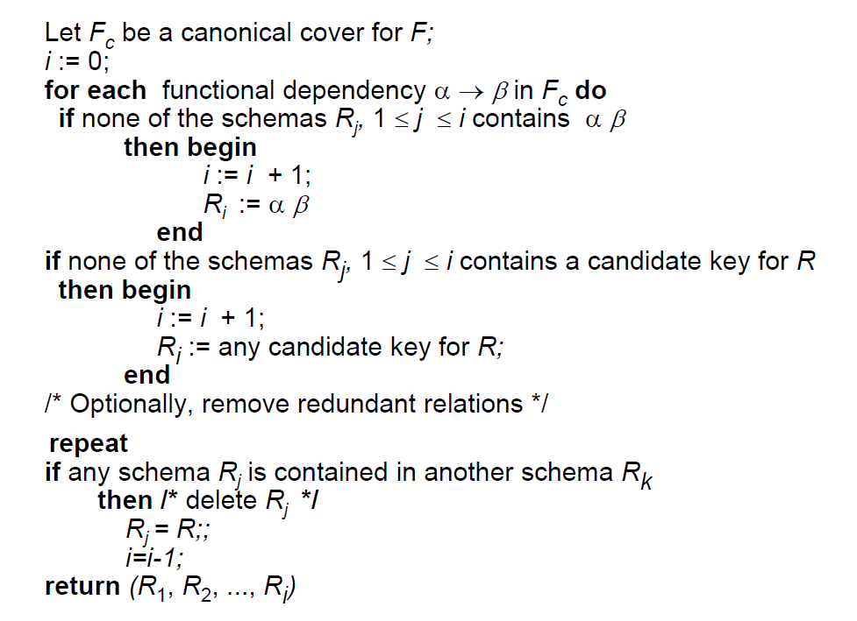
3NF Decomposition Algorithm

Slide 57
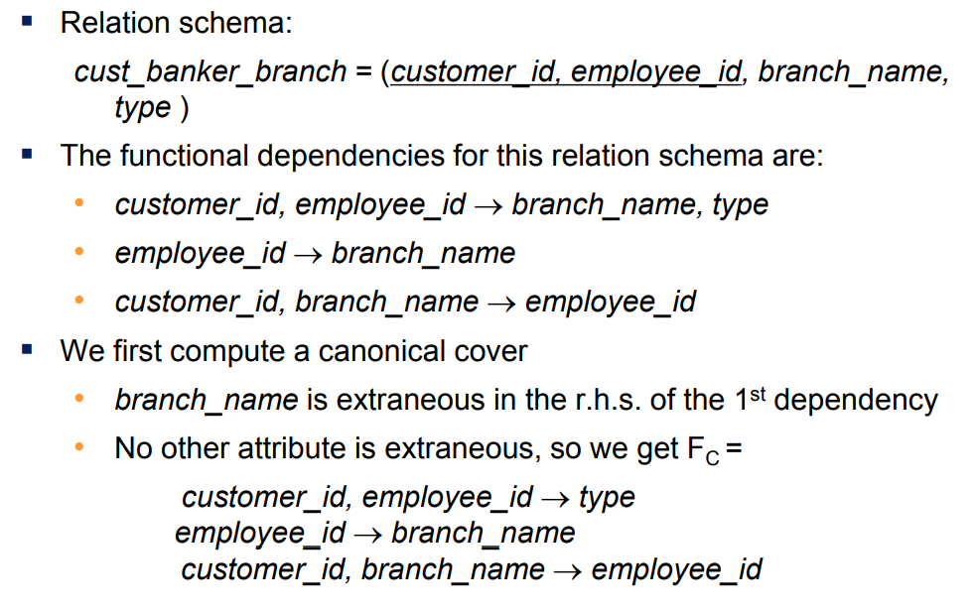
3NF Decomposition Example

Slide 58
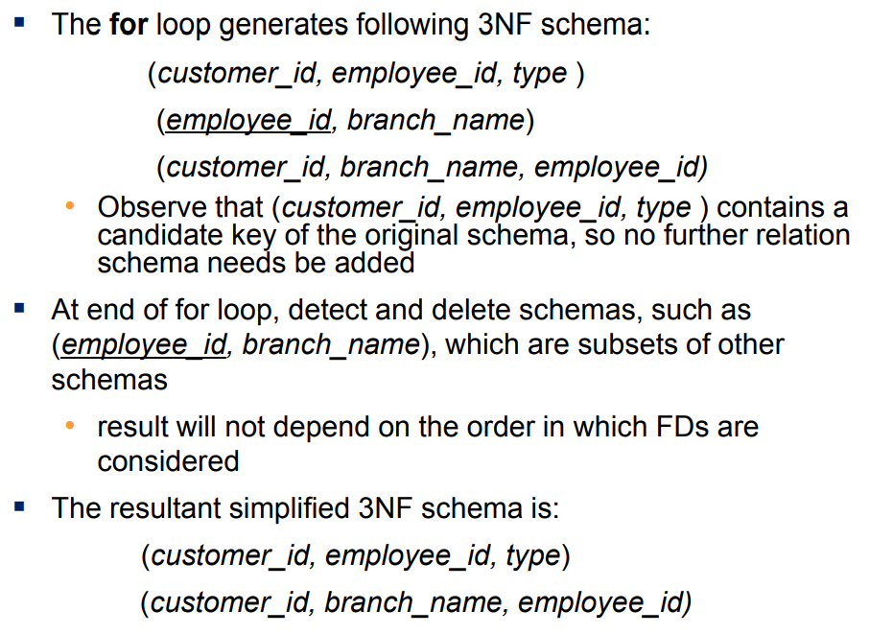
3NF Decomposition Example

Slide 59
ER Model and Normalization
When an E-R diagram is carefully designed, identifying all entities correctly, the tables generated from the E-R diagram should not need further normalization
However, in a real (imperfect) design, there can be functional dependencies from non-key attributes of an entity to other attributes of the entity

Slide 60
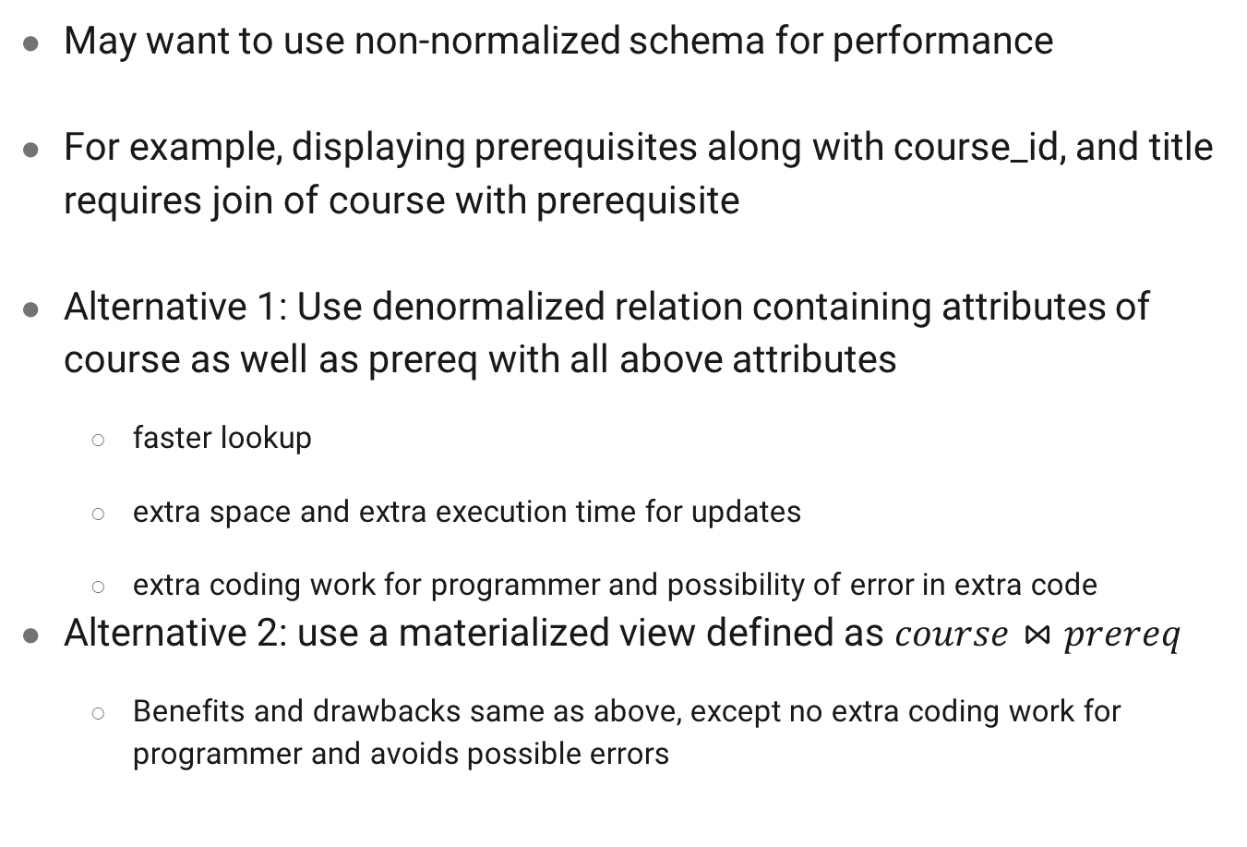
Denormalization for Performance
May want to use non-normalized schema for performance
For example, displaying prerequisites along with course_id, and title requires join of course with prerequisite
Alternative 1: Use denormalized relation containing attributes of course as well as prereq with all above attributes
faster lookup
extra space and extra execution time for updates
extra coding work for programmer and possibility of error in extra code
Alternative 2: use a materialized view defined as $course⋈prereq$
Benefits and drawbacks same as above, except no extra coding work for programmer and avoids possible errors

Slide 61
References
Database System Concepts - 6th edition (db-book.com)

